Slide 1
Construction of the alpha version of CDSS
Vjollca Sadiraj
Associate Professor
ExCEN and Economics Department
Georgia State University

Slide 2
Our Approach
Central elements:
Development of a decision-support software that effectively operationalizes the risk of readmission into the clinical provider’s daily work.
Reducing readmissions while maintaining or decreasing LOS
Clinical data warehouse was used in
a prediction model of readmission with validation

Slide 3
Patient Population
Dataset:
electronically collected information during the patient’s admission
Three types of data: binary, categorical, continuous
Demographic information (3, 4)
Comorbidity (1, 5)
Source of Admission (10, 2)
Procedures performed (33, 30)
Medications administered (34, 1)
Laboratory test results (15, 15)
Transfusion (6, 1)
Diagnostic imaging (6,1)
Nursing documentation (10,10)
Others (6, 7)

Slide 4
Demographic Information (3,4)
Age
Gender
Ethnicity
Constructed Variables (4):
PtAge: ( Age – M ) / S
Age in the dataset
M and S will be provided
MaleGender: 1=Male; 0=Female
WhiteRace: =1 if patient’s ethnicity is Caucasian or White
BlackRace: =1 if patient’s ethnicity is African American or Black

Slide 5
Comorbidity (1,5)
Comorbidity (5)
Ascites
CHD
Diabetes
Cancer
Hypertension
Constructed Variables (5):
For each of these 5 comorbidities, create an indicator variable that takes value
1 if a patient has it
0 if not.
Ascites– Ascites; CHF– CHD; DM – Diabetes; CANCER– Cancer; HTN– Hypertension.

Slide 6
Source of Admission (10,2)
Source of Admission (10)
COURT/LAW ENFORCEMNT, DO NOT USE, INFO NOT AVAILABLE, NON-HC FACILITY POO, PHYSIC OFC/CLINIC, TFR FRM AMB SURG CTR, TFR FROM OTHER HCF, TFR FROM SAME FACIL, TRANSFER FROM HOSP, TRANSFER FROM SNF
Constructed Variables (2):
Code the list from 1 to 10 using codes file provided
Emer Admit– takes value 1 if admission source code is 2 or 3
Reg Admit– takes value 1 if admission source code is 6, 7, 8, 9, 10

Slide 7
Procedure (33, 30)
Procedures Performed (33)
Above or Below Knee Amputation, Adrenalectomy, GI Fistula, Appendectomy, Bariatric Surgery, Hepato-Jejuno/Duodeno, Cholecystectomy, Colectomy, Pancreatic Debride, Soft Tissue Debride, GI Abscess Drain, Esophagectomy, GI Tumor Excision, Foot Amputation, PEH Repair, Gastrectomy, Gastro-Jejuno, Gastrorraphy, Ing-Fem Herniorraphy, Hepatectomy, Lysis of Adhesions, Mastectomy, Pancreatectomy, Parathyroidectomy, Pelvis Exenteration, Proctectomy, Reduc of Volvulus, Small Bowel Resect, Splenectomy, Enterotomy Repair, Thyroidectomy, Thyroidectomy, Ventral Herniorraphy
Constructed Variables (30):
Coded from 1 to 33 in order of the list (code file provided), then recode 14 as 1.
Procedure_i – if a patient undergoes procedure i, takes value 1; 0 otherwise; there will be 29 of these
Notes:
(We have too few observations on procedure 25 and 32 so they do no appear in the current model)

Slide 8
Medications Routes Administered (34, 1)
Medications routes administered (34)
34 routes are recorded, e.g. Epidural, G-Tube, J-tube, etc.
Constructed Variable (1): IVD
These 34 values need to be coded using the code file provided as Route1 to Route 7
IVD takes value
1 if a patient is prescribed to take medication via Routes 2 to 6,
0 otherwise (Route 1 or Route 7)

Slide 9
Laboratory Test Results (15, 15)
Laboratory test results (15)
Albumin, AlkPhos, AST/ALT, BUN, Calcium, Bicarb,
Cr, HCT, INR, K+, Sodium, PLT, PTT, TBili, WBC
Constructed Variables (15):
For each test result, x listed above, subtract M(x) and then divide by S(x).
test results are recorded in the dataset
M(x) and S(x) for each variable x will be provided

Slide 10
Transfusion (6, 1)
Transfusion(6):
CS Blood Bank Products (Transfuse),
Transfuse During Dialysis
Transfuse for HCT,
Transfuse for INR,
Transfuse for Platelet Count,
Transfuse Now
Constructed Variable(1):
TransufeD-takes value
0 if none of these transfuses is ordered for a patient;
1 if one ore more are ordered.

Slide 11
Diagnostic Imaging (6, 1)
Diagnostic imaging (6):
Angiography, CT Scan, MRI, Radiologic Exam, Supervision and Interpretation, Ultrasound Imaging
Constructed Variable(1):
DxImg--takes value
0 if none of these medical images is ordered for a patient;
1 if one ore more of these images area ordered.

Slide 12
Nursing Documentation (10, 10)
Nursing Documentation (10)
Katz Score, Stool+, BMI, HR, O2Sat, RR, DBP, SBP, TEMP, PainScore
Constructed Variables (10):
Each variable listed above, subtract its mean and then divide by its standard deviation
test results are recorded in the dataset
means and standard deviations for each variable will be provided

Slide 13
Other Variables (6,7)
Complexity(RVUs)– values recorded in the dataset, minus M then divided by S
UnivHosp vs Other– whether the patient is treated in Emory University Hospital (1 if yes)
HighRisk – takes value 1 if patient was not immediately operated on after admission
LOS – number of days in hospital
LnLOS– log of LOS
NPO– takes 1 if patient’s diet code is NPO
PreOptimize - a dummy variable that takes value 1 if the patient was admitted for a surgical procedure with the procedure delayed beyond the initial day of admission.

Slide 14
Example
Data Variables | N | M | SD | Model Variables | B | V (replace this with var/covar matrix)
Albumin | 4.15 | 5.58 | 3.92 | Albumin if NPO=0 | -0.038 | 0.098
 |  |  |  | Albumin if NPO=1 | -4.188 | 226.049
AlkPhos | 61.5 | 77.94 | 59.50 | AlkPhos | 0.029 | 0.113
K+ | 4.35 | 3.35 | 1.25 | K+ | 0.388 | 0.163
Sodium | 140 | 138.64 | 2.52 | Sodium | -0.061 | 0.119
PLT | 275 | 264.16 | 71.47 | PLT1 | -2.797 | 1.111 | * PLT1= ((PLT+3)/10)^0.5
 |  |  |  | PLT2 | 4.989 | 1.265 | * PLT2= ((PLT+3)/10)^0.5*LN((PLT+3)/10)
WBC | 7.35 | 8.12 | 2.64 | WBC | 0.066 | 0.106
Katz Score | 5 | 5.82 | 2.09 | Katz Score2 if Procedure=7 | 1.679 | 0.918 | * Katz Score 1 = (Katz Score +3.26)^(-2)
 |  |  |  | Katz Score2 if Procedure=22 | 1.369 | 1.289 | * Katz Score 2 = (Katz Score +3.26)^(-2) * ln(Katz Score +3.26)
 |  |  |  | Katz Score1 * Tbili | -1.532 | 0.944
 |  |  |  | Katz Score2 * INR | 0.469 | 0.382
Stool+ | 0 | 0.17 | 1.05 | Stool+ | 0.046 | 0.103
BMI | 35 | 31.49 | 7.02 | BMI | 0.017 | 0.083
TEMP | 36.95 | 36.87 | 0.37 | TEMP | -0.074 | 0.080
PainScore | 5 | 3.51 | 3.16 | PainScore | 0.029 | 0.089
LOS |  |  |  | LOS | 0.000 | 0.023
LOS2 |  |  |  | LOS2 | 0.787 | 0.218 | * LOS2=ln(LOS/10)
HighRisk |  |  |  | HighRisk | -0.487 | 0.398
Constant |  |  |  | Constant | 1.979 | 1.344

Slide 15
Data Processing
Time-varying variables were grouped for analysis by hospital day.
Variables reported more than once daily (up to 3) were averaged.
Missing data
the last known observed value of the variable carried over .
If a variable, x was never recorded, use the value N(x).

Slide 16
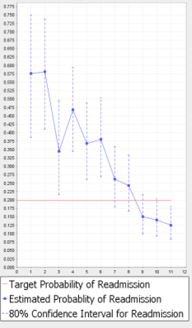
Output
A patient’s LOS may have been unnecessarily prolonged.
This patient stayed in the hospital for 7 days
With a target of 0.2 of the likelihood of readmission day 4 would have been optimal
If the value of P is
Above the target then recommend “Do not discharge”
Below the target and the upper value of P (UP) is
above the target then recommend “Physician Judgement”
Below the target then recommend “Discharge”

Slide 17
Derivation of point prediction pr, P and 80% C.I. [UP,LP]
Calculate Pr(Readmitted)
Y=XB
P : exp(Y)/(1+exp(Y))
Calculate error: E=sqrt(XVX’) if X is row vector-- this should return a scalar for each patient-day
Calculate 80% upper bound, UP
U =Y+1.28E
UP = exp(U)/(1+exp(U))
Calculate 80% lower bound, LP
L = Y– 1.28E
LP = exp(L)/(1+exp(L))

Slide 18
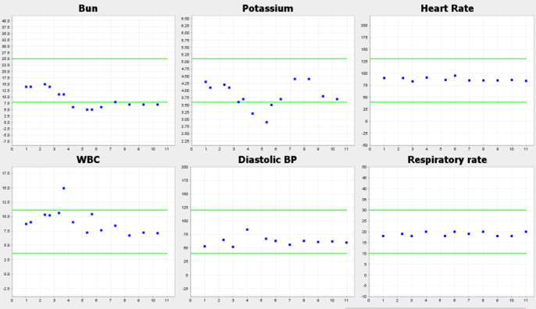
Selection and Display of the most important variables on daily basis
Rank variables according to the marginal effects (given to you)
Select the top six variables in that list
Display time series for each of them

Slide 19
Summary
Surgeons practice can be improved to reduce readmissions
They may discount the CDSS tool’s recommendations.
Creative strategies to incorporate the best data analysis with display modes are a necessary step for the uptake of such decision-support technologies

Slide 20
Construction of the alpha version of CDSS
Vjollca Sadiraj
Associate Professor
ExCEN and Economics Department
Georgia State University

